Slide 1
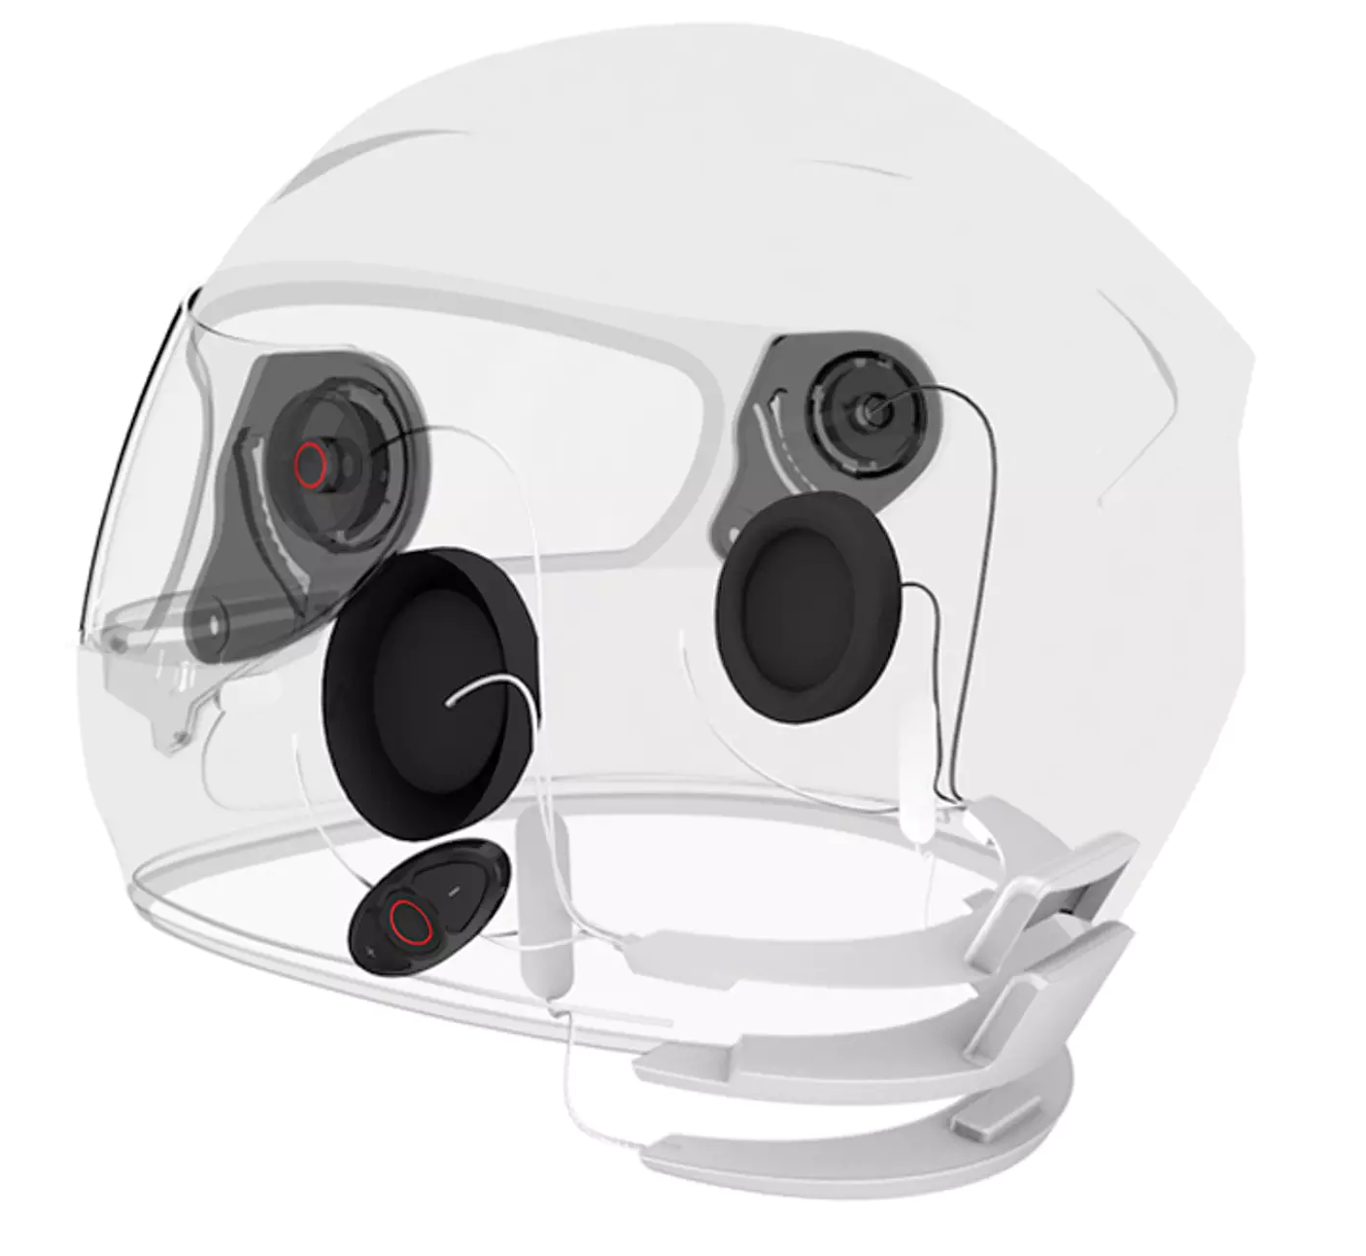
Shopping Without Vision
Group: Javabean
2017.2.24
Notes:
Hello, everyone! We come from Javabean group. Our final project topic is Shopping Without Vision. We are planning to design and build a website that help the blind shop online in an amazing way. Now let’s see how amazing our website is.

Slide 2
Team information
Team background: Computer Systems Engineering
Member information:
Pengyu Chen: User interface (HTML, CSS, JavaScript, Jquery, Java)
Ruofan Lyu: Database (MySQL, Java, Adobe Access)
Huizhe Wang: Database (MySQL, Java, Adobe Access)
Tianyu Wang: Back-end algorithm (Java, SpringMVC, algorithm)
Xiajie Zhang: Back-end algorithm (Java, SpringMVC, algorithm)

Slide 3
Project problem statement
Problems the blind will face when shopping online:
1. hard to use search engine
2. inconvenient to shop online
3. confused by different details of merchandise
Notes:
We found that all the online shopping websites are presented visually, which means people with visual impairment will have difficulty to browse and experience online shopping, they may face such problems, like:

Slide 4
Objectives
In order to help people with visual impairment shop online, we utilize the newly technology of stimulate human senses by low frequency current signals to tell users about the merchandise in a different way. It will empower them to
1. Shop by voice command
2. Feel how the merchandise is like
Notes:
These are objectives of our project. We found there is an advanced technology that to stimulate humans’ senses by low frequency current signals, so that the users could have some particular and real feelings. So we want to combine this kind of technology with the internet. On our website, the blind can shop by voice command, they just need to say the name of product they wanna buy, then the search assistant will translate voice into text for search engine and show the searching results. And then through our algorithm, each product’s features will be translated into different current signals. Then the blind will receive signals from helmet and touching pad, so that they could feel how the product is like in fact.

Slide 5
Project impacts
Number of the visual impairment : 40-45 million
Solve the problem: “shopping”
Penetrate to every aspect of life: working, studying, entertaining
Lead a normal life
Notes:
According to the records given by world health organization, the number of the blind is about 40-45 million. Our website is focus on solving shopping problem for the blind. Likes, they could buy clothes, books or whatever they want to buy. It will maximize the blind’s development, let them work, study, enjoy the daily life as equal as the normal.

Slide 6
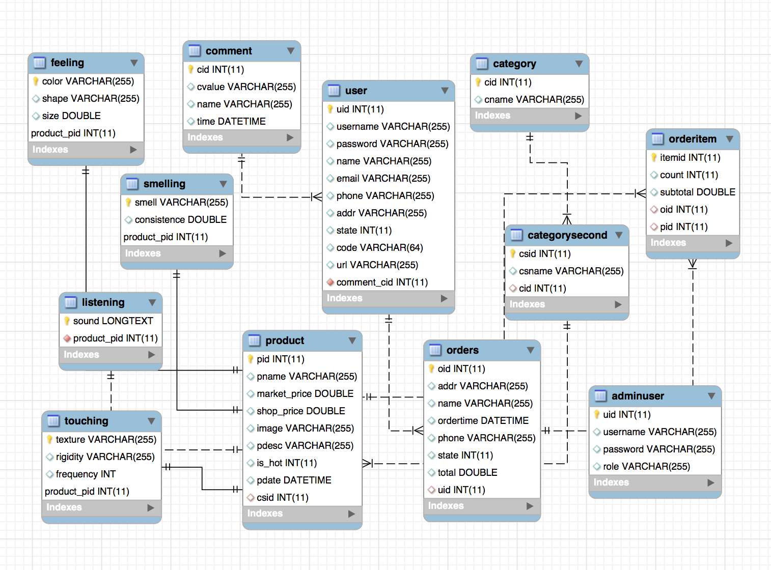
Required data
Notes:
There are just some parts of our whole tables. We will add more tables in future. Now, we can see that, on the function, the tables could be divided into two parts. One is for building the frame of online shopping site. We need a way for users sign up or sign in, we need manage and search products by categories, likes the pen is belong to the department learning tools, we also should give the product information to users, let them add items in cart, and check orders. Moreover, the website need give users a right to leave their comment, no matter they are criticism or the praise.
The other part is focus on the service for the blind. Now, there are four tables in this part, feeling, smelling, listening, and touching. These attributes of the four tables will store different kinds of current signals. These signals will let the blinds get the product information. And the relationship of current signals and product is one-to-one.

Slide 7
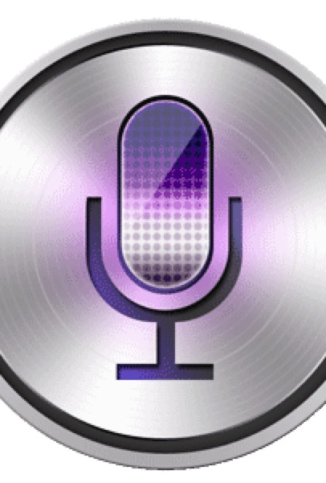
Existing technologies
Speech Recognition
The technology that develops methodologies and technologies that enable the recognition and translation of spoken language into text by computers. The system analyzes the person's specific voice and uses it to finetune the recognition of that person's speech, resulting in the increased recognition accuracy.
Notes:
Now I’ll give a brief introduction about some existing technologies related with our project. The first one is Speech Recognition. This technology is able to analyze person’s specific voice and use it to finetune the recognition of the person’s speech, this can result in the increased recognition accuracy. So we want to utilize this technology to our voice searching assistant function.

Slide 8
Existing technologies
ColorTest
The retina contains approximately 6 million retinal cone cells. Each cell is ‘color specific,’ responding mainly to light of specific frequencies. The three different types of cone cells correspond to the three primary colors: red, green and blue. The model of ColorTest utilized the latest research on the genetics of color blindness and various anomalies related to photopigments, and linked these into a model where it gives.
This technology promises the legally blind and those with low vision the ability to see in 20/20, all without the need for surgery.
Notes:
The second one is ColorTest. If you know the reason why we can see so many kinds of colors, you should know that the retina contains about 6 million retinal cone cells. Each cell is color specific. The model of ColorTest utilized the latest research on the genetics of color blindness and some other anomalies related to photo pigments. And this technology promises the blind to see in 20/20 without any surgery.

Slide 9
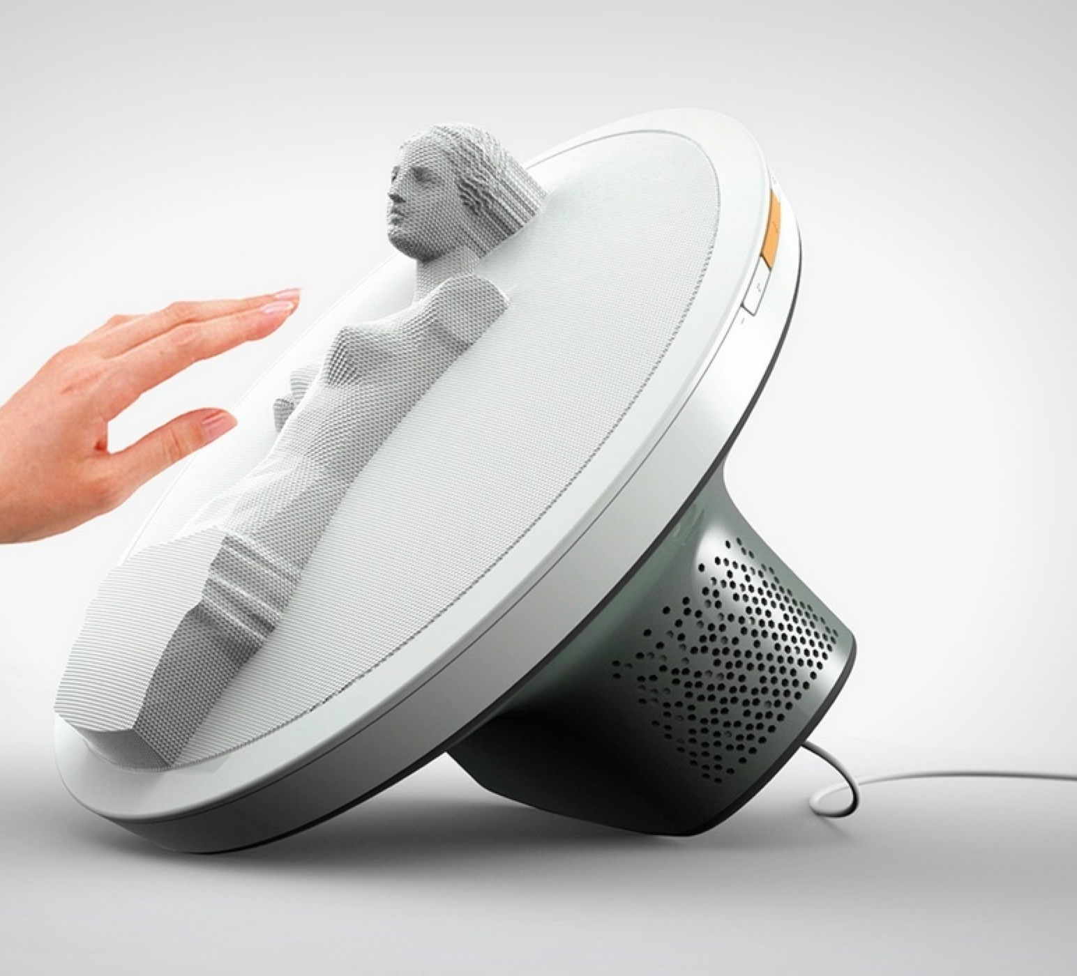
Existing technologies
Blintor
Blintor is a touchable monitor which has tiny particles that create a shape on the monitor surface and allows users to feel 3D images via their hands. It analyses depth and prepares a one-axis depth map, which it then feeds into the Blintor’s screen which manipulates its surface to make a 3D object stand out. The Blintor’s rim also has a touch surface that allows you to revolve the 3D data so as to be able to feel it in its entirety.
Notes:
The last one is a very advanced device that has plenty of tiny particles which can create a shape on the surface, so that users can feel the real shapes via their hands. So we want to utilize this technology to our touching pad. Because the blind cannot see the pictures on the screen, this pad will let them feel the shapes and hand feelings of each merchandise.

Slide 10
Our contribution and assumptions
Offer a voice searching assistant which can transfer voice to command.
Offer an algorithm that can transfer particular features to different low frequency current signals.
Offer a kind of wearable devices (such as helmet, touching pad) that can help users feel the merchandise in shape, size, and odor etc.
Notes:
According to the objectives of our website, we need the assistance of the third-part software, a voice searching is needed because the blind could transfer their voice to text command, then the website could get the command correctly and show the right product to the blind.
We also need write an algorithm to calculate the relationship between current signals and product information. Because we need transfer particular features to these signals for the blind.
Of course, a wearable device is indispensable. Such as helmet or a touching pad. Users could feel the shape, size and odor of products with them.

Slide 11
Constraints and limitations
Current signals may have to be adjusted for every individual.
It is an immersive device.
Need time to popularize it.
Notes:
We know that the activity in the brain varies from person to person. So the current signal have to be adjusted for every individual. Moreover, the device is immersive now. We need a company to produce the machine to match our website. And because it is a new website in a different way than in the past. We need time to popularize it.

Slide 12
Thank you!

